Slide 1


Portfolio.
Anushka Nerkar

Slide 2


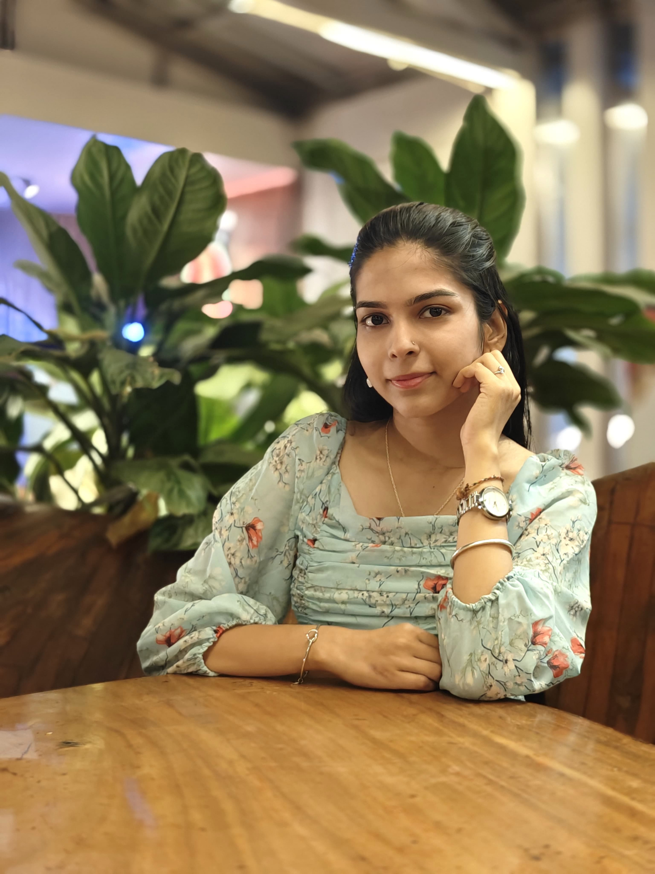
About me | Education | Experience | Skills | Projects | Academic | PPTs | Infographic | Visual Imprints| Get in touch
About Me
I'm Anushka Nerkar
Passionate about understanding markets, building strong brands, and creating meaningful digital campaigns using research and data-driven insights.

Slide 3
About me | Education | Experience | Skills | Projects | Academic | PPTs | Infographic | Visual Imprints| Get in touch
Education
ICSE Board
North Maharasthra University
(2018-2019)
(58.60%)
(2020-2021)
(73.50%)
North Maharasthra University
Savitribai Phule Pune University
(2021-2024)
(8.26 CGPA)
(2024-2026)
(7.73 CGPA)

Slide 4


About me | Education | Experience | Skills | Projects | Academic | PPTs | Infographic | Visual Imprints| Get in touch
Experience
Insplore Consultants:
1. Conducted SWOT and PESTLE analysis of financial products.
2. Executed a market research project on Social Media Marketing in BFSI, collecting and analyzing data from 100 respondents.
3. Created a video presentation on investment options in India.
4.Promoted Bank of Baroda's "Maha Jeevan Plus" insurance plan using direct and social channels.
(Marketing and Finance Intern)

Slide 5

About me | Education | Experience | Skills | Projects | Academic | PPTs | Infographic | Visual Imprints| Get in touch
Experience
FOTOOWL.AI:
  Created static posts, carousels, thumbnails, and social media content.
  Edited reels and videos and contributed to videography.
  Managed content publishing across Instagram, Facebook, Pinterest, and YouTube.
  Developed content ideas, captions, scripts, and coordinated creative approvals with the team.
(Social Media Intern)

Slide 6
About me | Education | Experience | Skills | Projects | Academic | PPTs | Infographic | Visual Imprints| Get in touch
Skills
Marketing:-
  Social Media Marketing
  Content Planning
  Market Research
  Campaign Support
Design & Content:-
  Canva
  Inshot
  VN Editor
  Alight Motion
  Content Creation
  Photography/Videography
Tools:-
  Microsoft PowerPoint
  Microsoft Excel
  AI Tools
Soft Skills:-
  Creativity
  Communication
  Teamwork
  Time Management
  Event Management

Slide 7
About me | Education | Experience | Skills | Projects | Academic | PPTs | Infographic | Visual Imprints| Get in touch
Projects

Slide 8
About me | Education | Experience | Skills | Projects | Academic | PPTs | Infographic | Visual Imprints| Get in touch
Academic:
  Study on the Role of Social Media Marketing in the BFSI Sector -
06 Jun, 2025 - 06 Aug, 2025
Mentor: Mr. Yash Varma
Project Link: https://docs.google.com/presentation/d/1rtWTMBBtljiWN82m120YZAV6n-n5CZRc/edit? usp=drivesdk&ouid=113300424746385638965&rtpof=true&sd=true
This project analyzed how social media marketing influences customer trust and engagement in the BFSI sector. Based on a survey of 100 respondents, it found that while platforms like Instagram, LinkedIn, and Facebook are widely used, trust and transparency issues still impact customer perception. The study suggests improving authenticity and transparency to enhance engagement.
  Study of challenges in managing multi-brand social media portfolios -
Mentor: Mr. Harjeet Singh
Project Link: https://docs.google.com/presentation/d/1T_Wfn-y61UQ39D_OtN7pp764jM70dl8C/edit? usp=drivesdk&ouid=113300424746385638965&rtpof=true&sd=true
This project focused on understanding the challenges companies face while managing multiple brands on different social media platforms. It involved studying how each brand maintains its unique identity, creates engaging content, and handles audience interactions. The project helped me gain practical insights into social media strategy, content planning, and performance analysis, while improving my creativity, coordination, and analytical thinking.

Slide 9
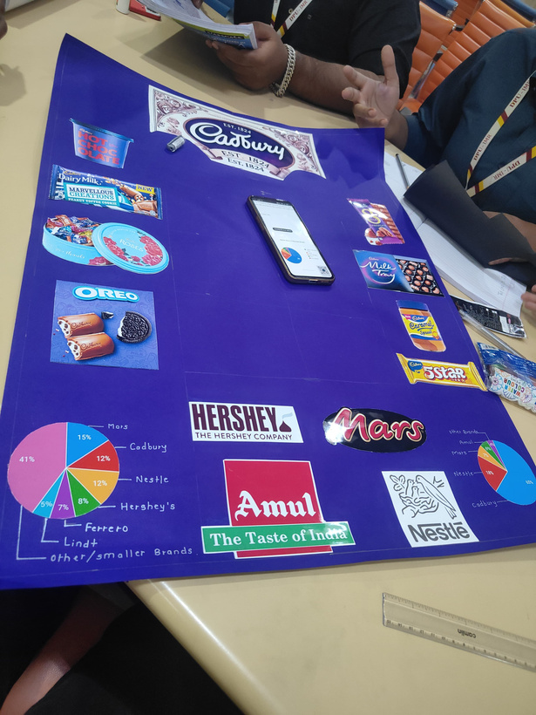
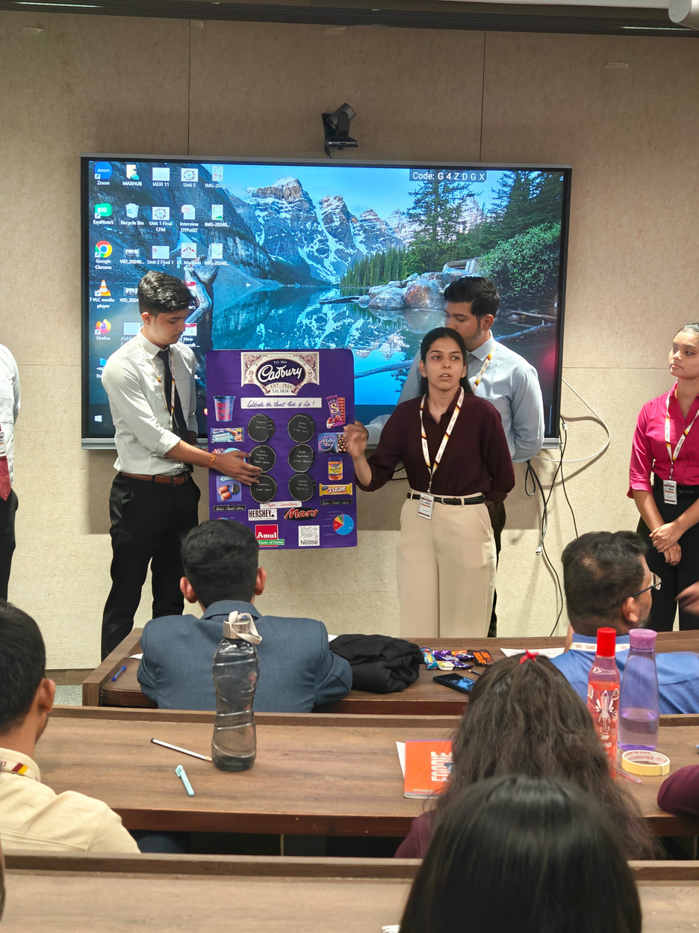
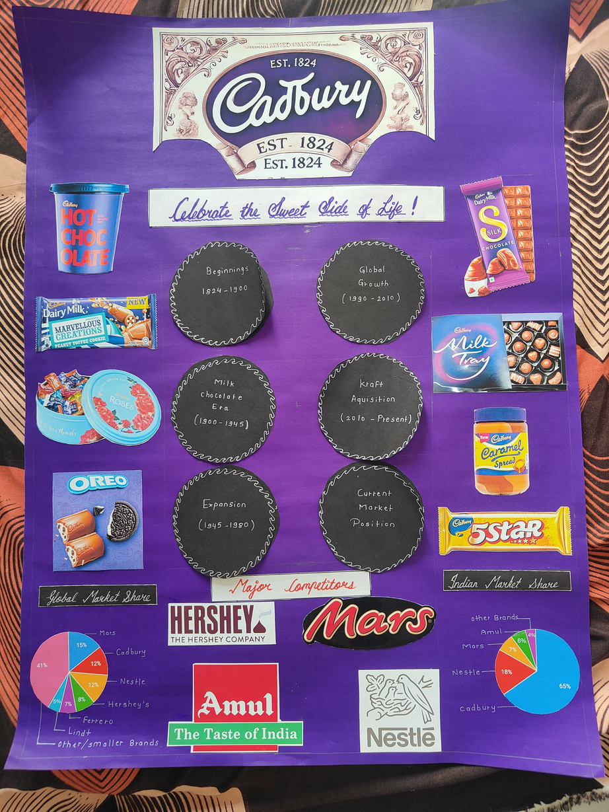

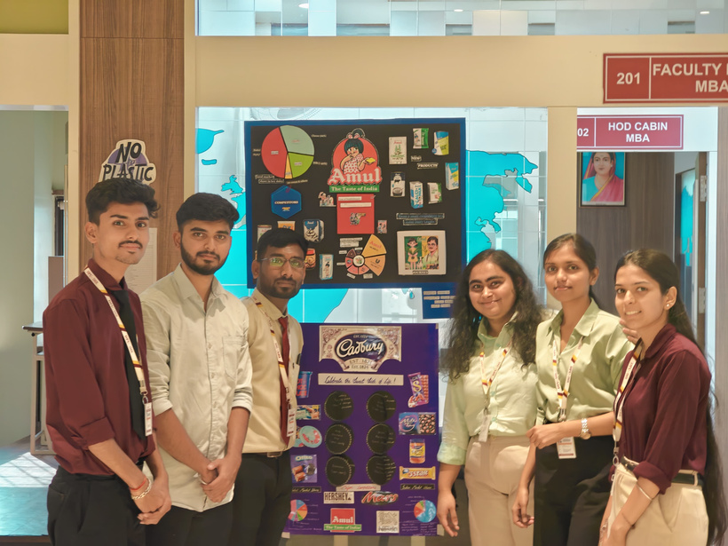


About me | Education | Experience | Skills | Projects | Academic | PPTs | Infographic | Visual Imprints| Get in touch
Academic:
Marketing Poster
November 2024

Slide 10
About me | Education | Experience | Skills | Projects | Academic | PPTs | Infographic | Visual Imprints| Get in touch
PPTs
  Tanishq - https://canva.link/dl4ic0oz3a3hw4m
  OJT Report - https://canva.link/g6dr2o1a75vbhll
  Internship Report - https://canva.link/0v4akimty03kmv3
  Field Work Report - https://canva.link/y5lypdgpr8ell7j
  PI Food Ltd - https://canva.link/38nmiax37sayhm8
  DMART - https://canva.link/oxl75ki5al0cbjf
  Invest Mango - https://canva.link/bldcrdj6iiun1tg
  Financial Sectors - https://canva.link/xg1amk1tr6niv67
  Risk Management Strategies - https://canva.link/vk8cji1ysezpcu1
  FMCG Sector - https://canva.link/02c7lkvbn0820jx
  Meridian - https://canva.link/66dkbghpesnxed4
  Kotak Bank - https://canva.link/i9w7bz95s5g5l7r

Slide 11
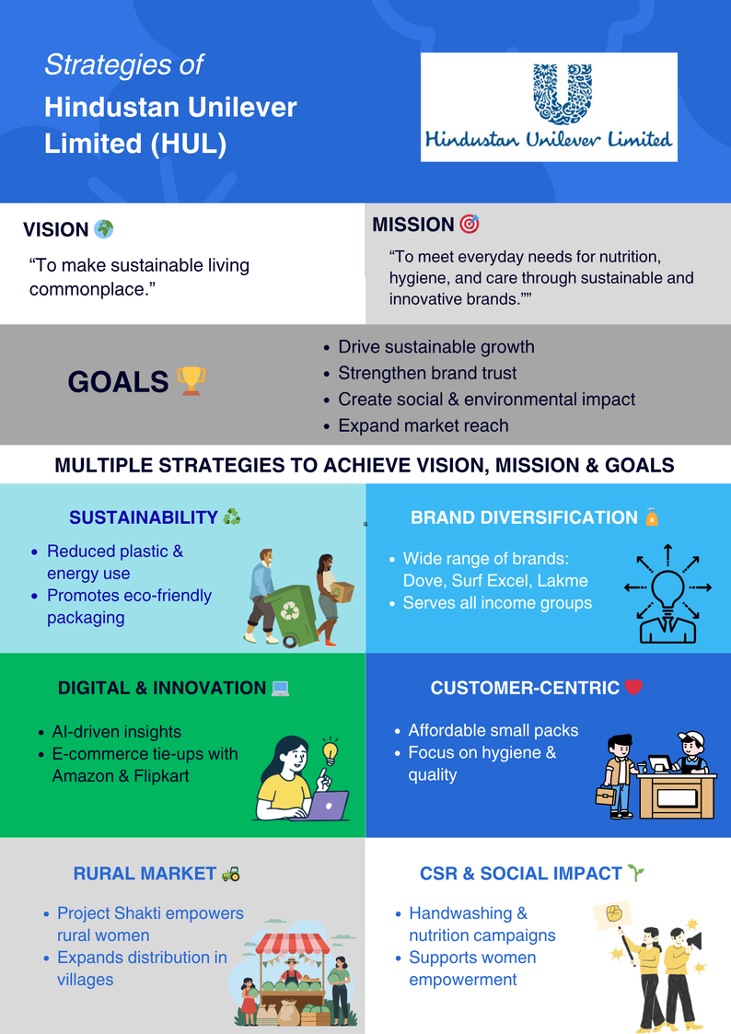
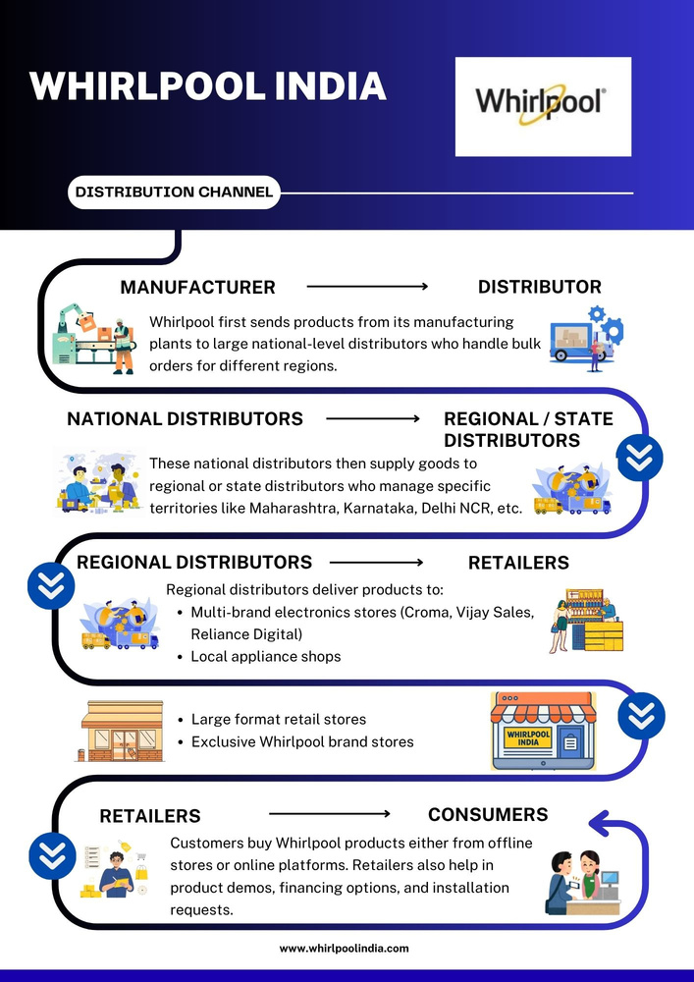
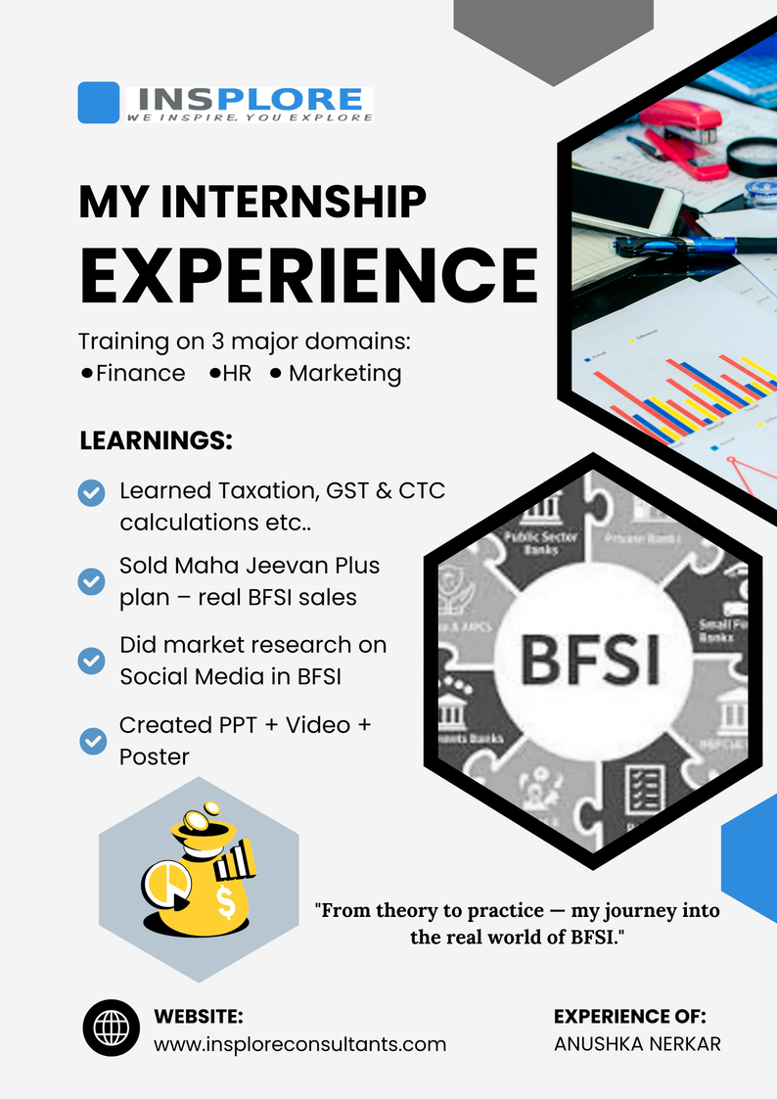
About me | Education | Experience | Skills | Projects | Academic | PPTs | Infographic | Visual Imprints| Get in touch
Infographics
  Zomato Infographic- https://canva.link/dl4ic0oz3a3hw4m
  Mahasangram - https://canva.link/ml30x7tfrs3q7gh
3.
4.
5.

Slide 12


About me | Education | Experience | Skills | Projects | Academic | PPTs | Infographic | Visual Imprints| Get in touch
Visual Imprints
LOGO DESIGN
INVITATIONS
  Skyora Developers - https://canva.link/wlmlm676qc7l439
Wedding Invitations:
  https://canva.link/oz659zfnijvs5wn
  https://canva.link/qt9rbj0qv4zwvcl
2.
Navratri Batch:

Slide 13
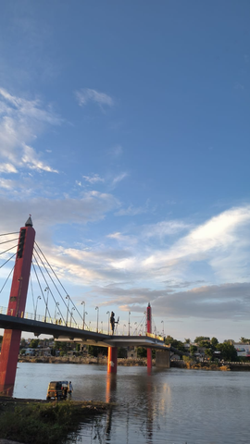
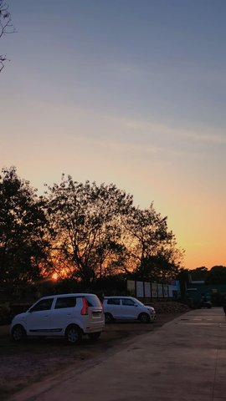
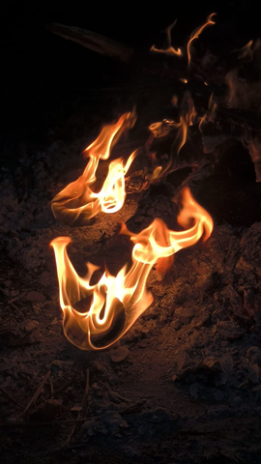
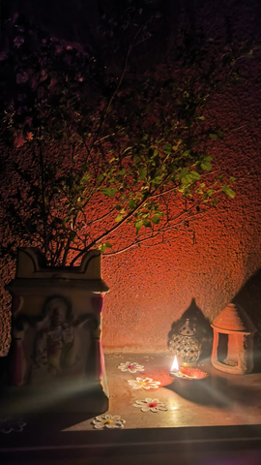


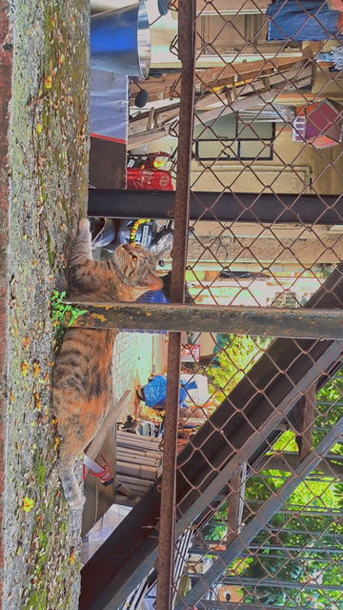
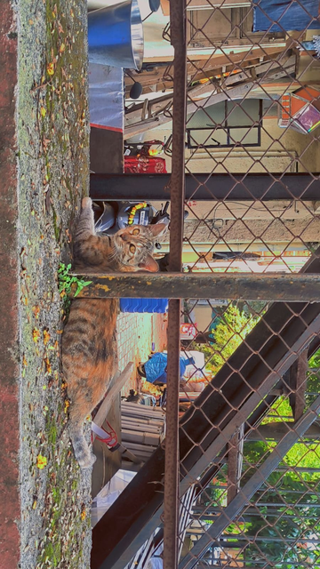
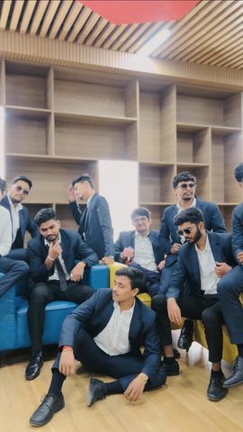
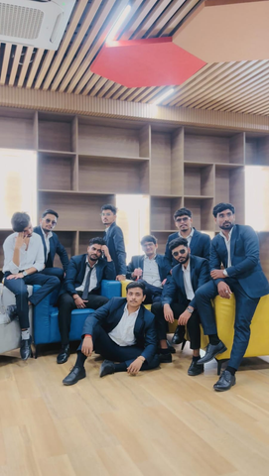
About me | Education | Experience | Skills | Projects | Academic | PPTs | Infographic | Visual Imprints| Get in touch
Visual Imprints
Photography:
Videography:

Slide 14
About me | Education | Experience | Skills | Projects | Academic | PPTs | Infographic | Visual Imprints| Get in touch
Email :
nerkaranushka09@gmail.com
Get in touch:
LinkedIn :
www.linkedin.com/in/anushka-nerkar-231928279

Slide 15
Thank You

